Slide 1
Lecture 1: Introduction
CS 550: Machine Learning
Instructor: Dr. Gagan Raj Gupta

Slide 2
Motivation for Machine Learning
Build systems that support humans by either improving upon existing human capabilities or providing new capabilities

Slide 3
Motivation for Machines that “Learn”

Slide 4
Motivation for Machines that “Learn”: Class

Slide 5
Motivation for Machines that “Learn”

Slide 6
Motivation for Machines that “Learn”

Slide 7
Motivation for Machines that “Learn”
It is hard to hand-craft a complete set of rules
We, as humans, may not devise the best rules for a machine since our brains (unconsciously) pre-process the data we sense

Slide 8
Automatically adapting to change

Slide 9
Helping Humans Learn

Slide 10
Summary
To summarize, Machine Learning is great for:
Problems for which existing solutions require a lot of hand-tuning or long lists of rules: one Machine Learning algorithm can often simplify code and perform better.
Complex problems for which there is no good solution at all using a traditional approach: the best Machine Learning techniques can find a solution.
Fluctuating environments: a Machine Learning system can adapt to new data.
Getting insights about complex problems and large amounts of data.

Slide 11
Some Examples

Slide 12
Introduction to Machine Learning

Slide 13

Machine Learning (ML)
Designing algorithms that ingest data and learn a model of the data
The learned model can be used to
Detect patterns/structures/themes/trends etc. in the data
Make predictions about future data and make decisions
Modern ML algorithms are heavily “data-driven”
No need to pre-define and hard-code all the rules (infeasible/impossible anyway)
The rules are not “static”; can adapt as the ML algo ingests more and more data

Slide 14


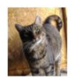

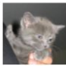
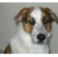
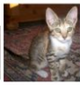



ML: From What It Does to How It Does It?
ML enables intelligent systems to be data-driven rather than rule-driven
How: By supplying training data and building statistical models of data
Pictorial illustration of an ML model for binary classification:
A Linear Classifier (the statistical model)

Slide 15
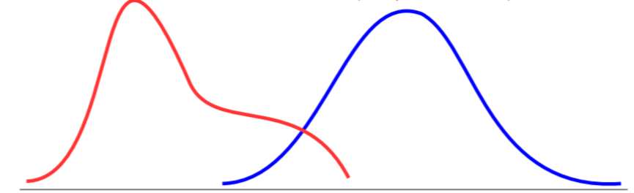

ML: From What It Does to How It Does It?
ML enables intelligent systems to be data-driven rather than rule-driven
How: By supplying training data and building statistical models of data
Pictorial illustration of an ML model for binary classification:
A Probabilistic Classifier (the statistical model)
P(“cat”|image)
P(“dog”|image)

Slide 16
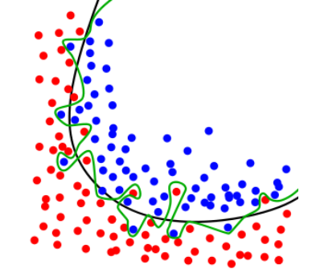
Overfitting = Bad ML
Doing perfectly on training data is not good enough
A good ML model must generalize well on unseen (test data)
Simpler models should be preferred over more complex ones!

Slide 17
Course Logistics
Course Name: Machine Learning – CS550
A graduate level course, with pre-requisite of Programming and basic Math
First Part: Fundamentals of Machine Learning
Second Part: Neural Networks and Deep Learning
Lectures + 1 tutorial every week
Monday 5 p.m.: Tutorials (Provide math basics and necessary coding skills)
Wed 8:30 am + Fri 11:30 am: Lectures
URL: https://github.com/gagan-iitb/CS550/
Canvas: TBD
All material will be posted on the Github/Canvas page
Discussions, Submissions on Canvas

Slide 18
Attendance Policy
75% attendance in lectures is mandatory to appear in Tierce Exam
Percentage will be calculated every segment for the lectures in that segment!
9 lectures => 7 lectures minimum
10 lectures => 8 lectures minimum

Slide 19



Course Team
Gagan Raj Gupta
gagan@iitbhilai.ac.in
Anirban Haldar
anirban@iitbhilai.ac.in
Suraj Kumar
suraj@iitbhilai.ac.in
https://www.iitbhilai.ac.in/index.php?pid=gagan

Slide 20
Workload and Grading Policy
Marks | Grade
>85 | A+
>80 | A
>70 | A-
>60 | B
>50 | B-
<30 | F
Programming assignments + Projects (worth 60%)
7 assignments covering different aspects of ML
Project Track: Hardware also available in EECS Lab
Projects can be done in groups of 2
Do any 2 assignments outside of the project area to get some breadth
Assignment Track:
Those new to ML are not expected to do projects
Attempt all 7 assignments if possible
4 out will actually be used for grading
Homework assignments (Applied Math) worth 10%
Attempt all, submit any 2 out of 4
Homework preferably typeset in Word/LaTeX (learn if not already familiar)
To be submitted via Canvas (login details will be provided)
3 Tierce exams worth 30%
Best 2 of 3 will be used for grading
Application of concepts on small problems
One of them could be a mini-Hackathon with Leader Board as well!
Class participation
Upto 5% (bonus)
LaTeX: www.sharelatex.com/blog/latex-guides/beginners-tutorial.html
www.overleaf.com/learn/latex/Tutorials

Slide 21
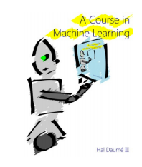

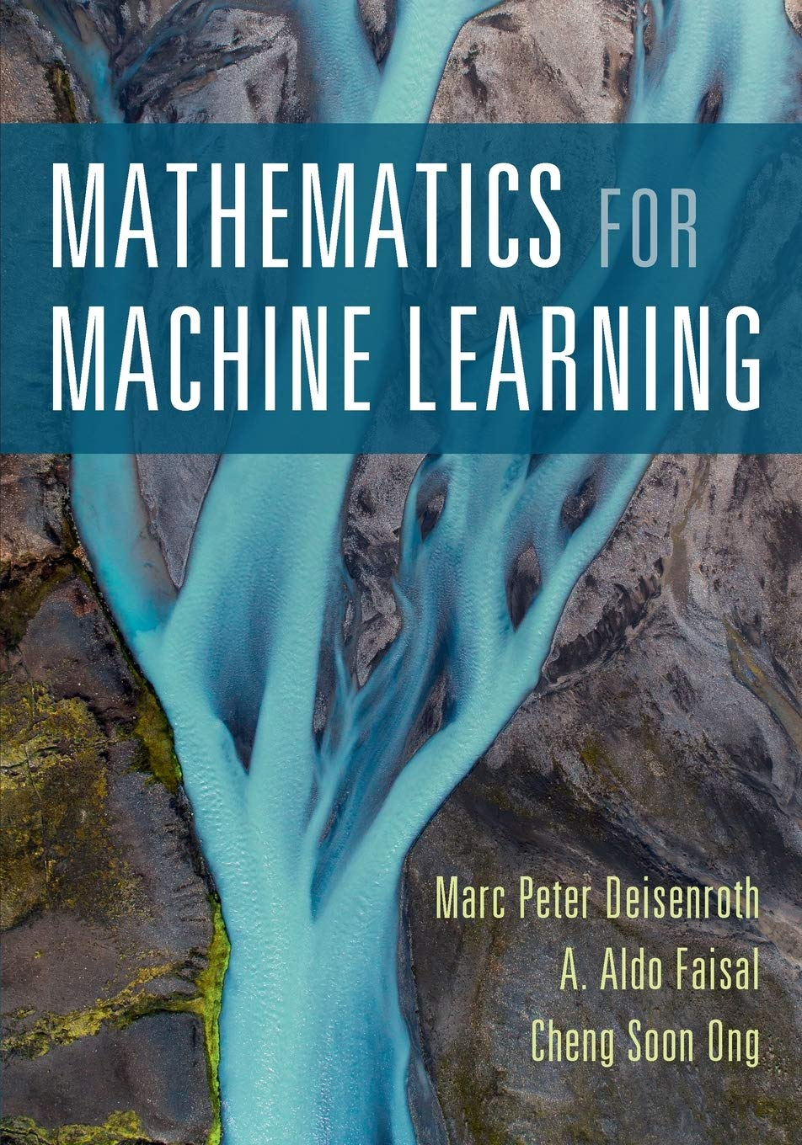
Textbook and References
Required Textbooks:
Hands on Machine Learning
Best programming resource
A course in Machine Learning
Easy introduction to concepts
Mathematics for Machine Learning
Best resource for math concepts
We will provide you the reading material from the relevant sources

Slide 22
Course Goals..
Introduction to the foundations of machine learning models and algos
Focus on developing the ability to
Understand the underlying principles behind ML models and algos
Understand how to implement and evaluate them
Understand/develop intuition on choosing the right ML model/algo for your problem
(Hopefully) inspire you to work on and learn more about ML
Introduction to popular software frameworks and libraries, such as scikit-learn, PyTorch, Tensorflow, etc

Slide 23
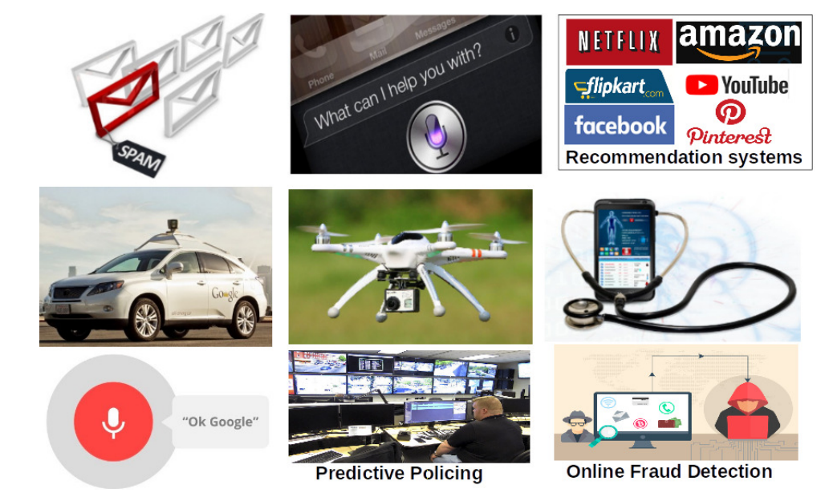
ML Applications Abound..
Picture courtesy: gizmodo.com,rcdronearena.com,www.wiseyak.com,www.charlesdong.com

Slide 24

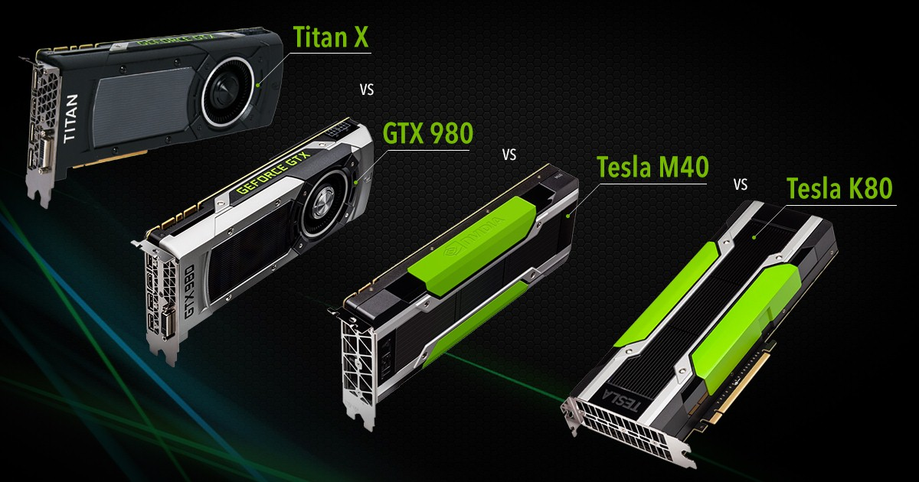
Key Enablers for Modern ML
Availability of large amounts of data to train ML models
Increased computing power (e.g., GPUs)

Slide 25
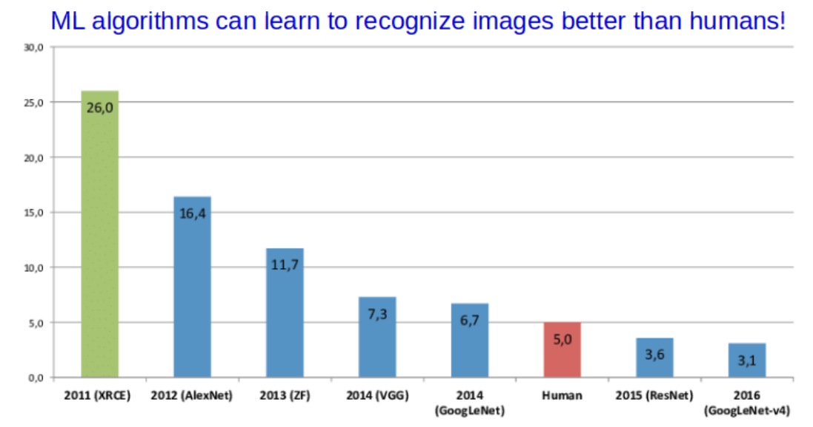
ML: Some Success Stories

Slide 26
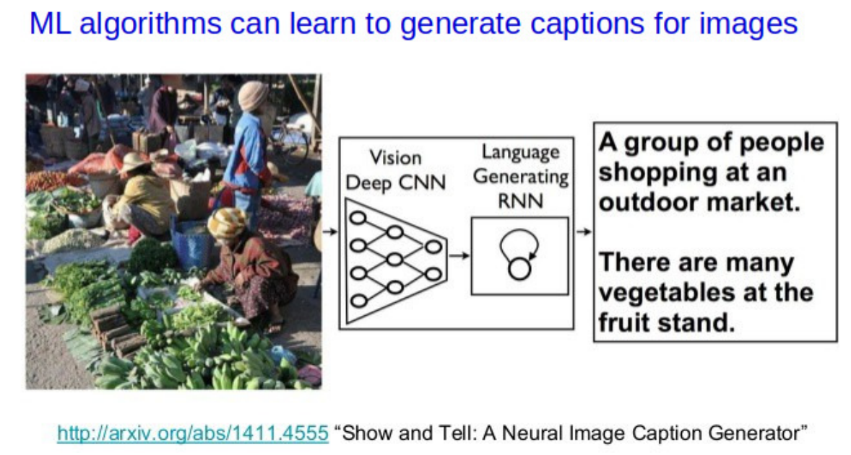
ML: Some Success Stories

Slide 27
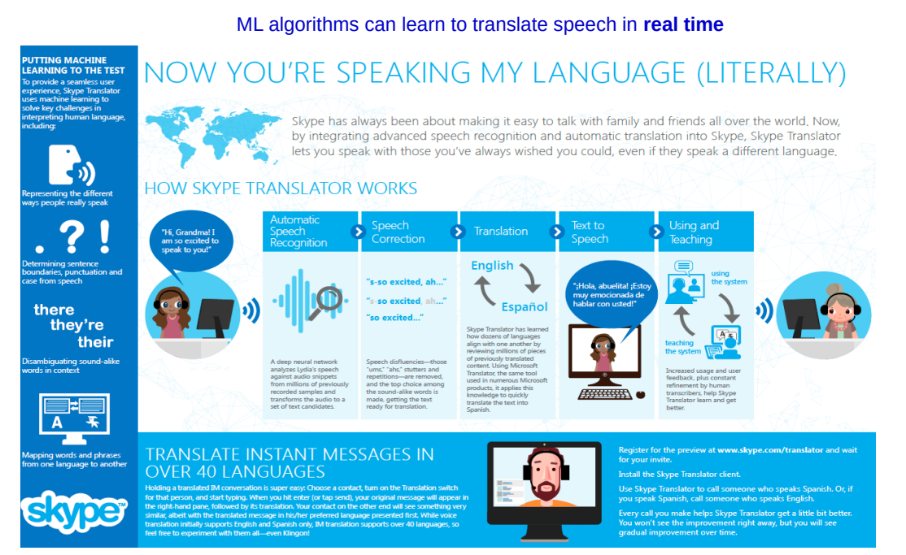
ML: Some Success Stories
Picture courtesy: https://news.microsoft.com/

Slide 28
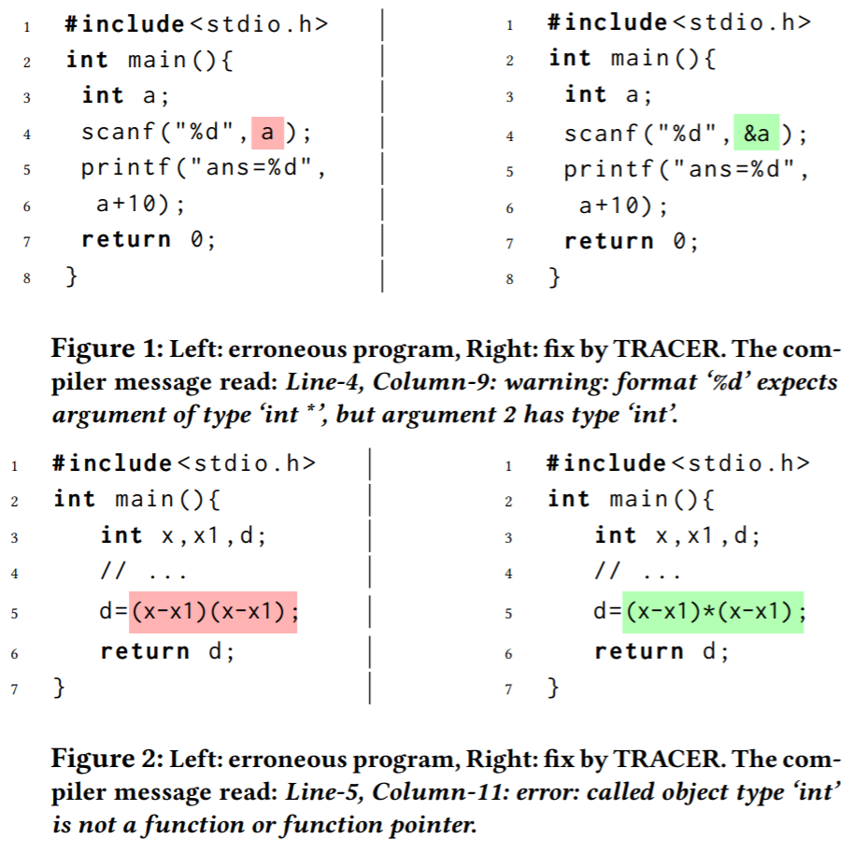
ML: Some Success Stories
Automatic Program Correction
Example from “Compilation error repair: for the student programs, from the student programs”, Ahmed et al (2018)

Slide 29
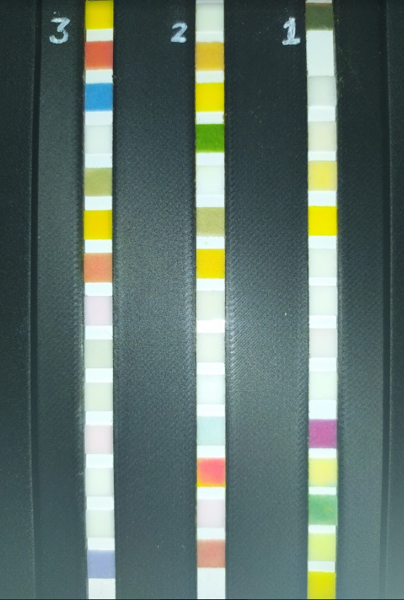
ML: Some Success Stories
ML based colorimetry for water quality assessment
Take uncontaminated water sample
Spike it with known concentration of various compounds (e.g., lead, iron, fluoride, etc)
Dip a test strip (one square to measure each compound) in the contaminated water for some time.
Take a picture of the strip using a phone camera to capture how the colors have changed
Train an ML model to predict concentration levels of various compounds based on color levels in the images
(work being done at IITK in collaboration with two startups - Earthface Analytics Pvt Ltd and Kritsnam Technologies Pvt Ltd)

Slide 30
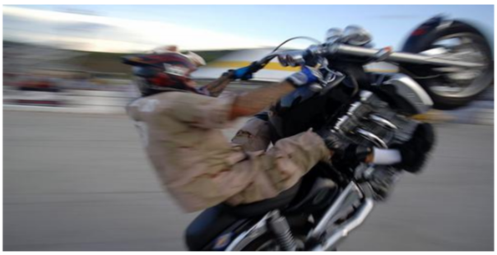

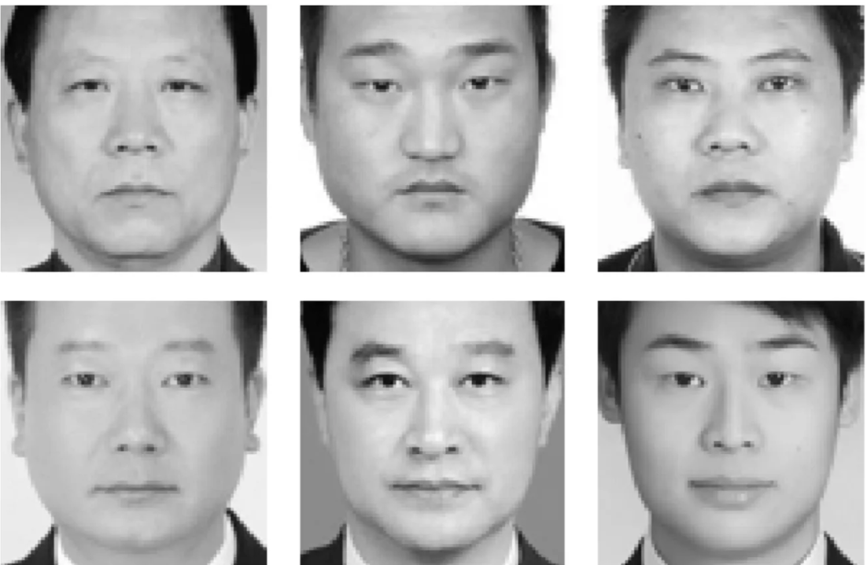
Good ML Systems Should be Fair and Unbiased
Good ML should not just be about getting high accuracies
Should also ensure that the ML models are fair and unbiased
A lot of recent focus on Fairness and Transparency of ML systems
Criminals?
Not Criminals?
An image captioning system should not always assume a specific gender in examples like the above
Don’t want a self-driving car that is more likely to hit black people than white people
Don’t want a predictive policing system that predicts criminality using facial features
Picture courtesy: Bhargava and Forsyth (2019), https://www.thestranger.com/, Xiaolin Wu and Xi Zhang, “Automated Inference on Criminality Using Face Images”

Slide 31
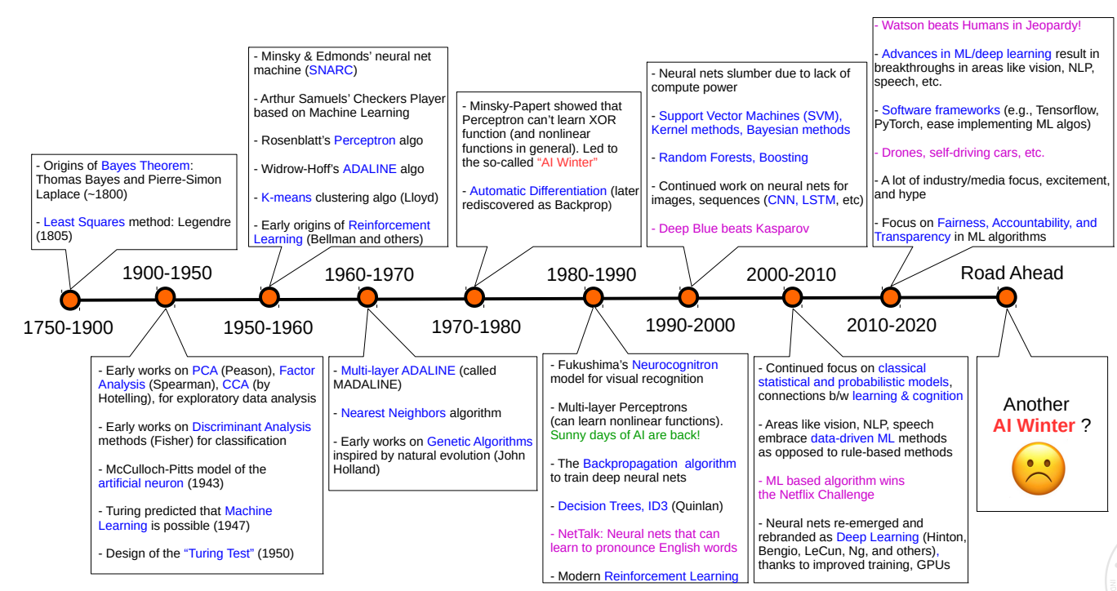
Looking Back Before We Start: History of ML
- Human-like text generators (GPT-3)

Slide 32
Credits
Dr. Piyush Rai’s CS771 lectures at IIT Kanpur

